Slide 1
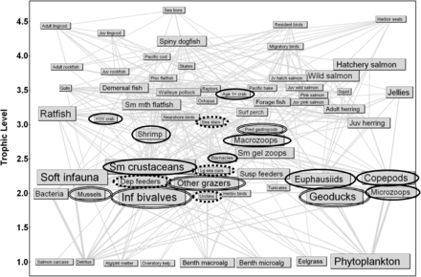

Figure 1. Food web model of Puget Sound's central basin, with 65 functional groups (Harvey et al., 2010). Box size is ...
Notes:
Figure 1. Food web model of Puget Sound's central basin, with 65 functional groups (Harvey et al., 2010). Box size is proportional to biomass, and the width of connecting lines is proportional to energy flow from prey to predator. Functional groups included in ocean acidification scenarios are circled. Single line = crustaceans, double line = molluscs, dashed line = echinoderms.
Unless provided in the caption above, the following copyright applies to the content of this slide: © United States Government 2013© United States Government 2013

